Slide 1

AIR QUALITY ANALYSIS AND PREDECTION USING MACHINE LEARNING
By
N. Vinod Kumar
Under guidance
of
Dr.Anjali Gautham

Slide 2
Abstract
Analysing and Predicting air quality is a complex task due to the dynamic nature, volatility, and high variability in time and space of pollutants and particulates. We forecast the air quality of India by using machine learning to predict the air quality index of a given area. Air quality index of India is a standard measure used to indicate the pollutants such as “ so2, no2, rspm, spm.” which plays and act as harmfull gases at particular level extents. We developed a model to predict the air quality index based on historical data of previous years and predicting over a particular upcoming year as a Gradient decent boosted multivariable regression problem. We are able to create a models which will helpful to predict harmfull situations base on the envirolment measures which will actually saves Human lifes at particular instances of time.

Slide 3
Introduction
Air contamination is the biggest perturb of present environmental studies due to the proclivity of industrialization some air pollutants are harmful inhaling them can escalate the chance of having health complications. People with heart or lung disease, older adults and children are at considerable risk from tainting of air. The major causes of air pollution will be because of burning of fossil fuels, gases emitted from automobiles, ammonia which is used in agricultural activities, factories and industries etc. Mining activities can also be a reason for air contamination as harmful chemicals are released from below the earth while extracting minerals The preliminary air contaminators in urban areas comprise of carbon dioxide (CO2), carbon monoxide (CO), nitrogen oxides (NO2), nitrogen monoxide (NO), and particulate matters PM2.5, PM10. Nevertheless, the major air pollution factor is PM2.5 or particulate matter which is up to 2.5 microns in diameter. These particles are tiny and light allowing them to survive in the atmosphere for an extended period and also comfortably bypass the filters of human nose and throat due to their size attribute.

Slide 4
Machine learning algorithms have been used in fields of computer vision speech recognition natural language processing audio recognition social networking and filtering, machine translation bioinformatics, drug design medical image analysis, material inspection and board game programs etc. The methods produce comparable surpassing human expert performance Logistic regression predicts the probability of a target variable is a supervised learning technique. The proposed model analyses the air quality based on various pollutant concentrations. A machine learning model is designed using linear regression and decision trees to predict the air quality index based on historical air quality data on various basic parameters

Slide 5
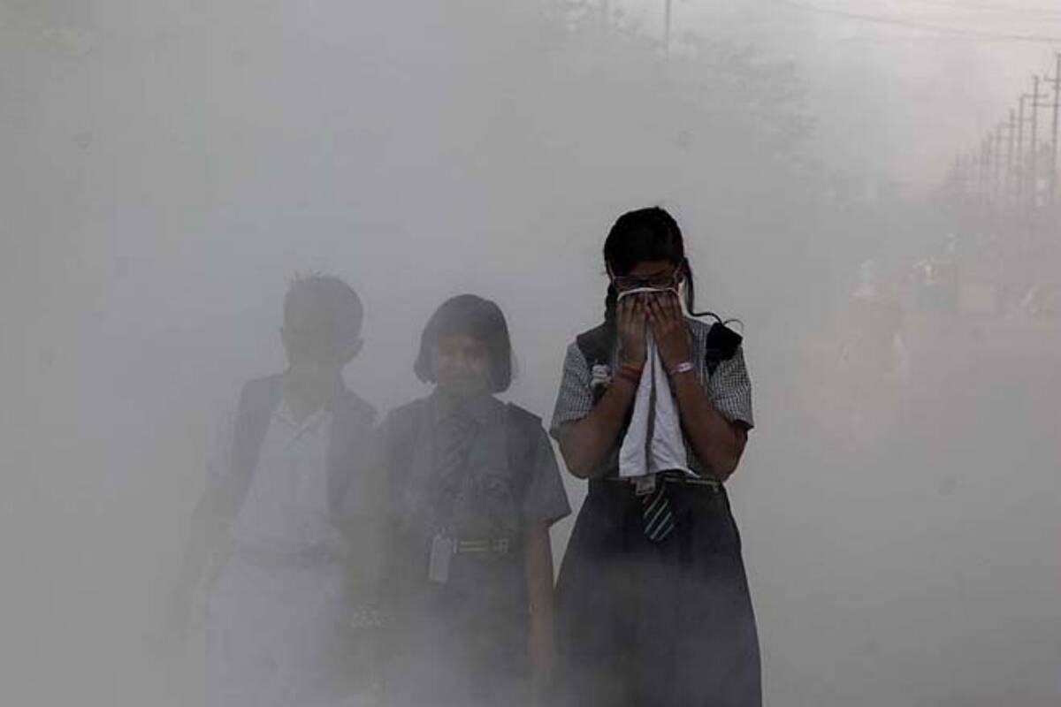
Source –Times of india
Levels of air pollutants in Indian cities, including national capital New Delhi, are on the rise, according to a study using observations from instruments on satellites that scan the global skies

Slide 6
Objectives
The overall goal of this project the air quality of Bharat by a mistreatment machine learning Algorithms to Predicts the air a quality index (the aqi). An air quality Index could be normal live to work out the standard of air. A concentration of Gases the asso2, a no2, the co2, an rspm, SPM. Etc. rerecorded by the agencies. A model to Predict the air the quality index had supported historical information of previous years and predicting over Specific approaching the year as a multivariable Regression drawback. They were improved the potency of the Model by applying the price Estimation for the prognostic drawback we are able to say that this model is capable Of successfully predicting the air a quality index shall of a year to be the increase region supplied with the Historical information of a waste product concentration this system has used the Linear regression and Multilayer Perceptron (ANN) the protocol for a prediction of the pollution of the next day.
This plan the system stem would
Two necessary tasks
Observe and Analyse the changes occurred in Air Trends (india ). Point out critical regions dangerous levels of pollution recorded marking those as frequent observing zones.
Making machine learning model with Maximum prediction accuracy. Idea generation to Delpoying the model and making those as API services to implement in IOT devices which detect and warns about pollution surrounding them to take safety measures to protect themselves.

Slide 7
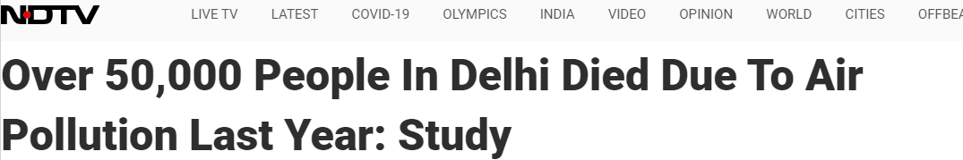
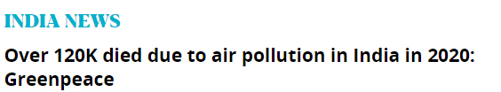
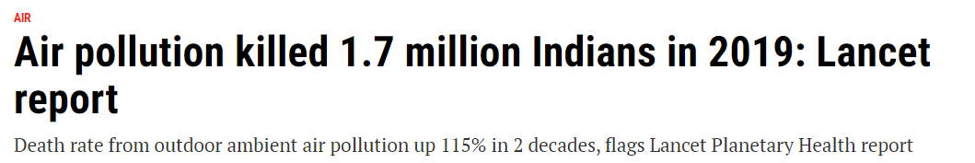
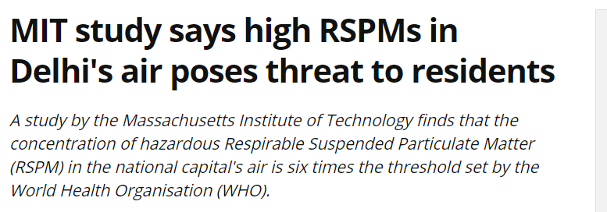
Motivation
Learning and working for Commercial companies may not satisfy me always. But doing something which actually saves humans from death and severe diesases will always satisfy me and make me a better person in society I believe.

Slide 8
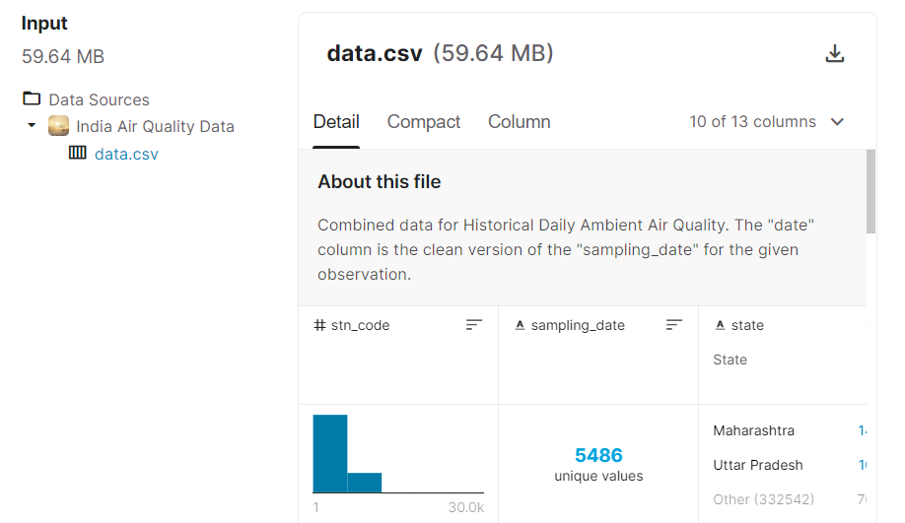
Source for Data Collection (Kaggle)
Link - Indian Air Pollution data Analysis | Kaggle

Slide 9



Tools required for Building Model
Visualisation tool->

Slide 10




Required Python Libraries

Slide 11
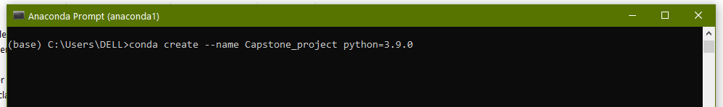
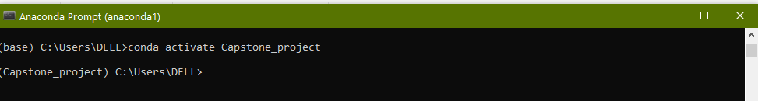
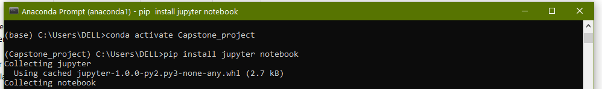
Project Envirolment setup (Anaconda)
Step-1 Open Anaconda prompt & Creating project Envirolment
Step-2 Activating Created Envirolment
Step-3 Installing Jupyter Notebook in created Envirolment

Slide 12
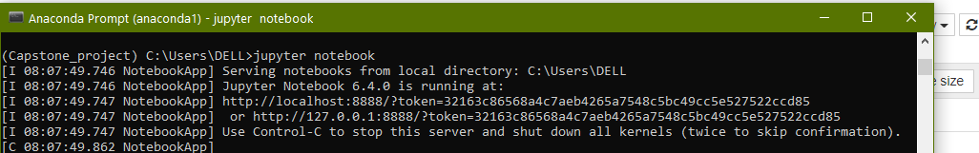
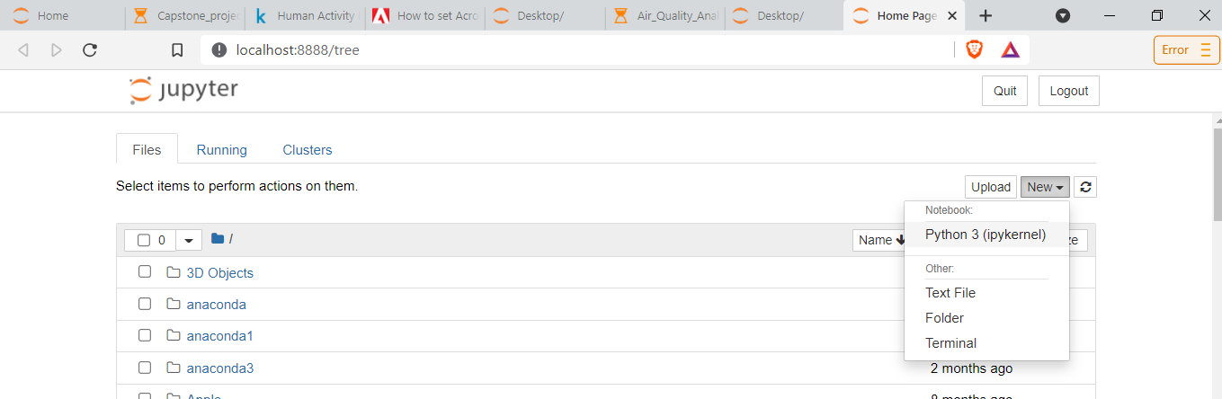
Step-4 Launching Jupyter notebook
Step-5 Creating New python File

Slide 13
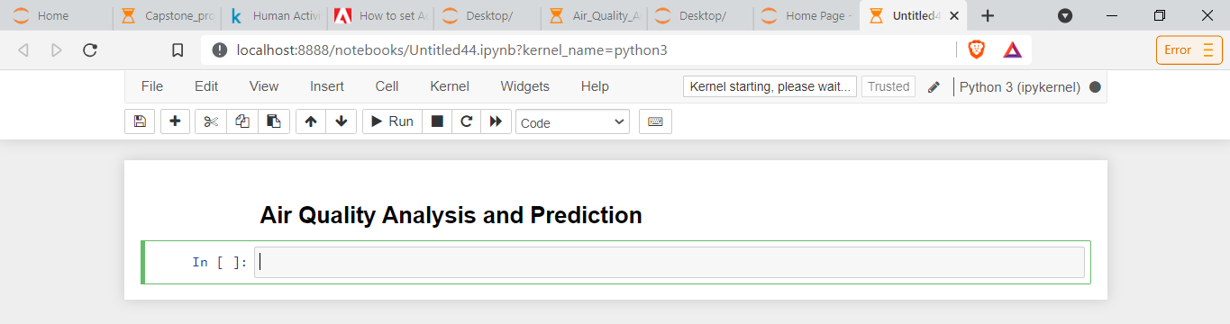
Step- 6 Initialising Project

Slide 14
Timeline
Choosing Project 4-July
Intial study About Project 5-July - 10 July
Reaserching related Projects 10-July- 15 July
Enirolment Creation 16- July
Getting know about Envirolment & Libraries 17-July-27-July
Preparing presentation for Review 1 28-July-29-July
Review-1 30 July
Initialising practical project 1-August
Analysis 2-August – 7-August
Working on Tabluea 8-August - 10 August
Research & Building ML model 10-August – 20 August
Finalising the project outcomes 20-August - 25-August
Final Review 30 August

Slide 15
Thank you

